Slide 1
The Missing Semester of Your CS Education
Version Control and Git

Slide 2
The “old” way
Code as managed by each developer
To create a “release”, copy all files into a new directory, and name it something like ”Release-v1.2.1”
Developers would all have different versions of the same files
Onboarding new developers was a pain
“It works on my machine” was rampant

Slide 3
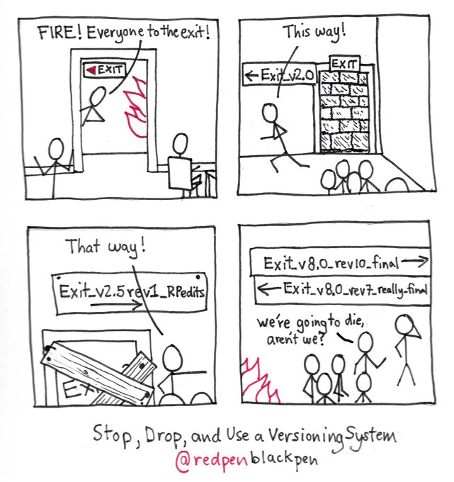

Slide 4
Enter: Version Control
Helps teams manage source code over time
Keeps track of every single modification, when it was made, what was changed, who made it, etc.
Code can be “rolled back” to any pervious version at any time
Conflicting changes made by different developers will be flagged, and prevented from being added without manual intervention

Slide 5

Git
Developed by Linus Torvalds, the developer of the original Linux Kernel
Strong performance when compared to alternative version control options
“Gits” out of the way of a developer, allowing them to develop without interference
Integrates security, hashing the files it tracks to maintain security
Defacto version control system; while there are alternatives, they are rarely used

Slide 6
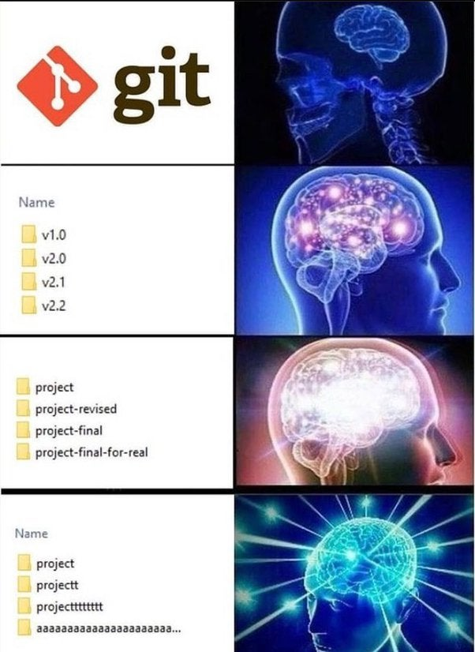

Slide 7
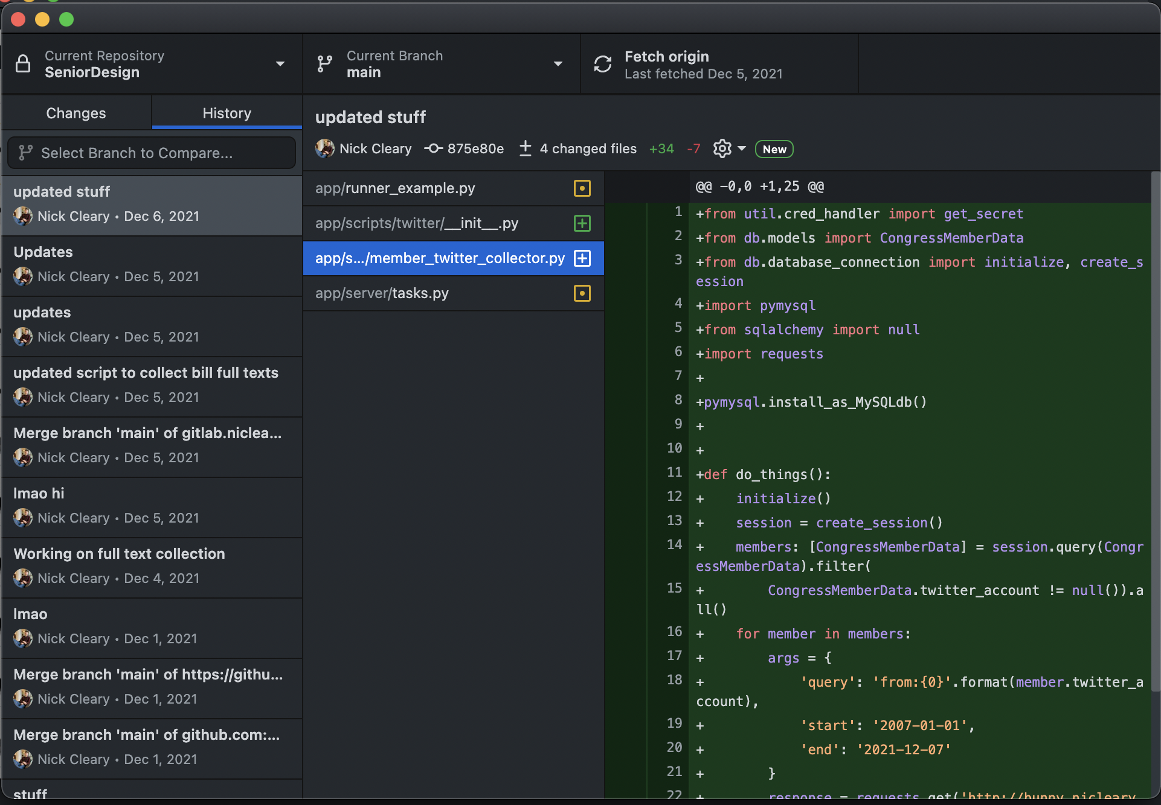
Using Git:GUIs
A variety of GUI options exist
Github Desktop (seen here, and will be used during this demo)
Source Tree
GitKraken
Most IDE’s and Text Editors have Git Support built in

Slide 8
Using Git: Terminal
Installed by default on most Linux systems
In Ubuntu, install with “sudo apt install git-all”
Most commands are a single line, and easy to remember
Easily used with a batch script
Most development workflows already involve a terminal, so why not use it?

Slide 9

Github
Github is to Google Drive as Git is to Google Docs
A place to store your Git repositories that isn’t on your local machine
Allows multiple developers to easily collaborate on a Git Repository
Widely used by open-source software

Slide 10

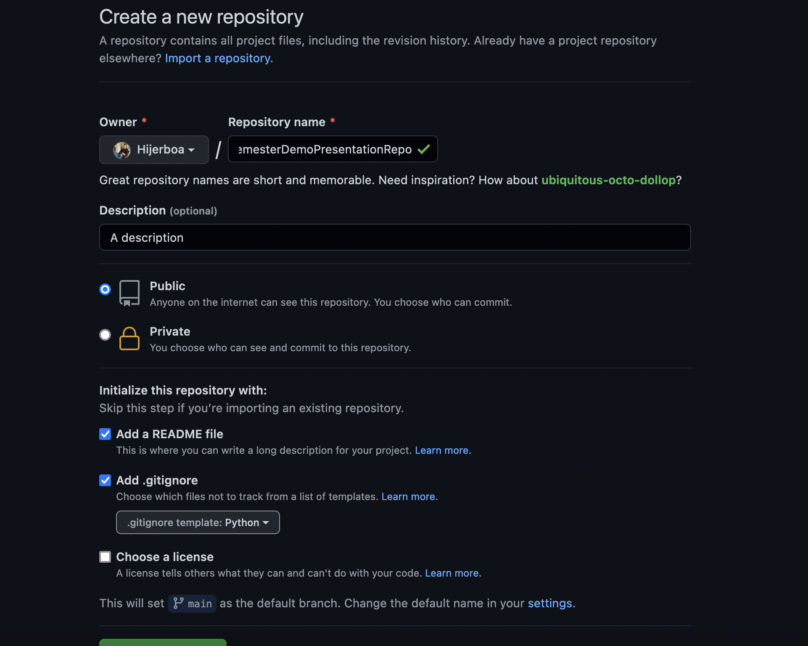
Let’s Get Started
First, create a repository on github.com

Slide 11
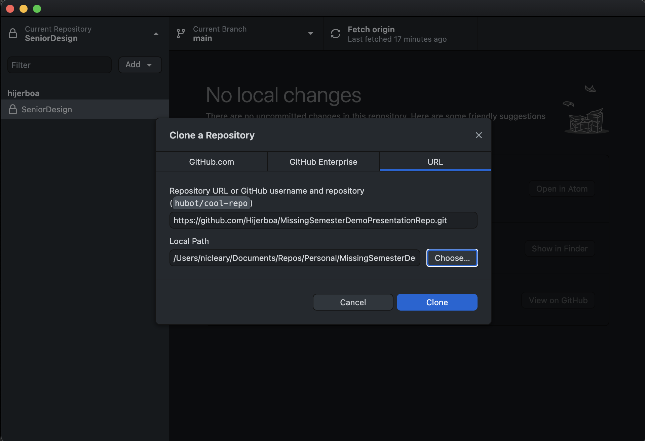
Cloning The Repository
Clone: To copy the repository to your local machine

Slide 12
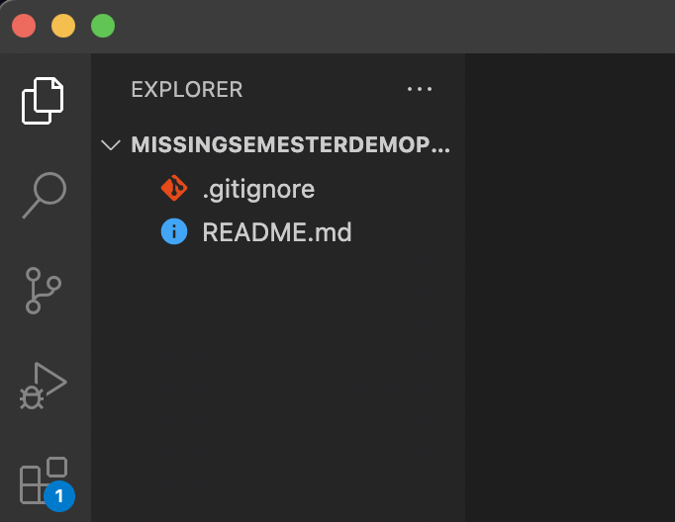
Open the folder you cloned
Use your favorite text editor—seen here is Visual Studio Code (VS Code)

Slide 13
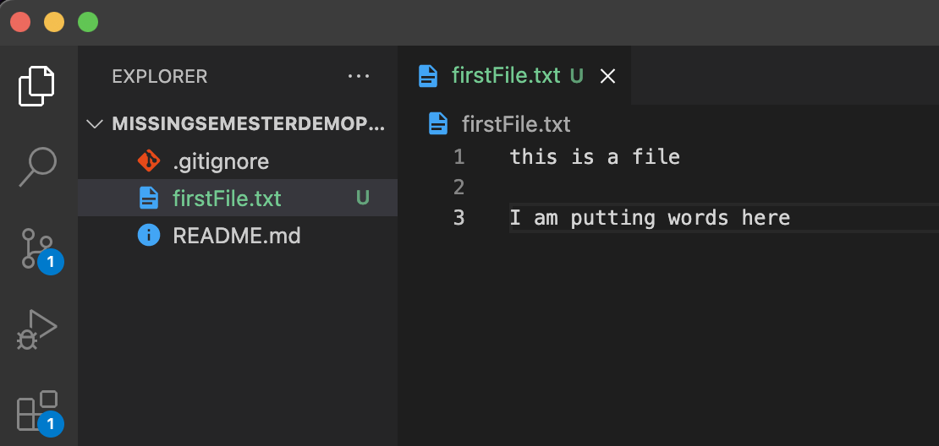
Lets add a file and write some text to it

Slide 14
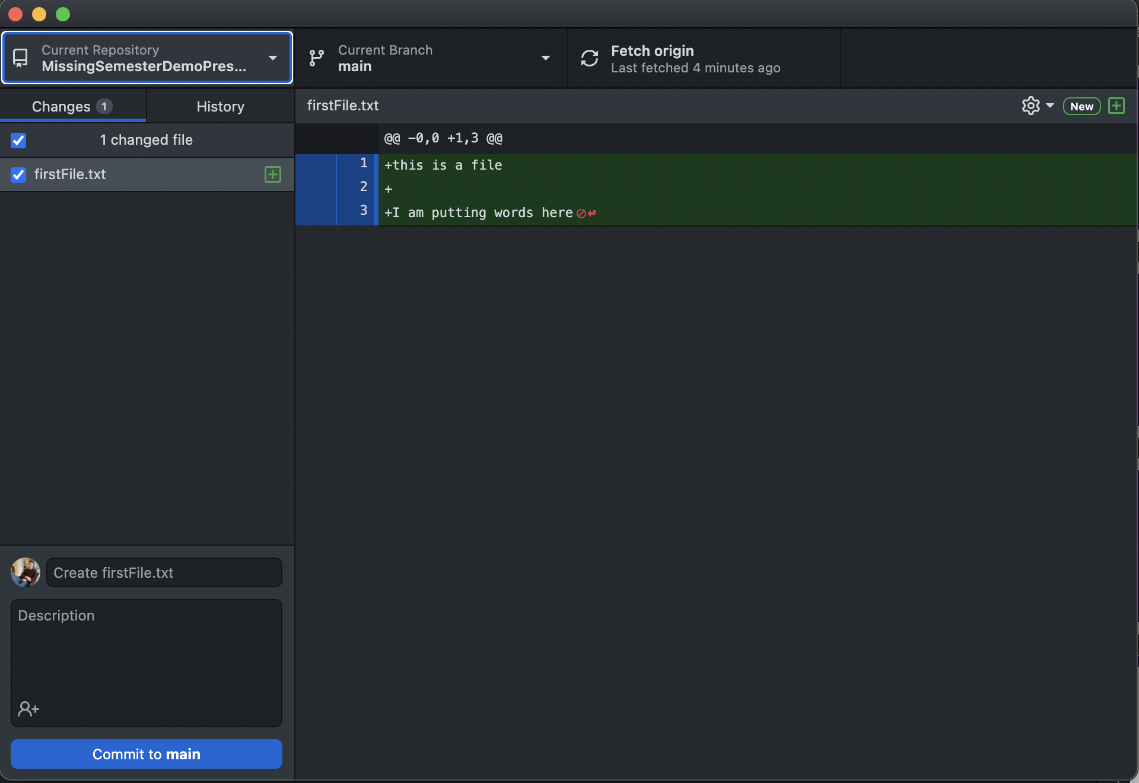
Committing changes
Back to Github Desktop
Git sees the changes we made, in this case adding a file
Those changes we made are now highlighted for us

Slide 15
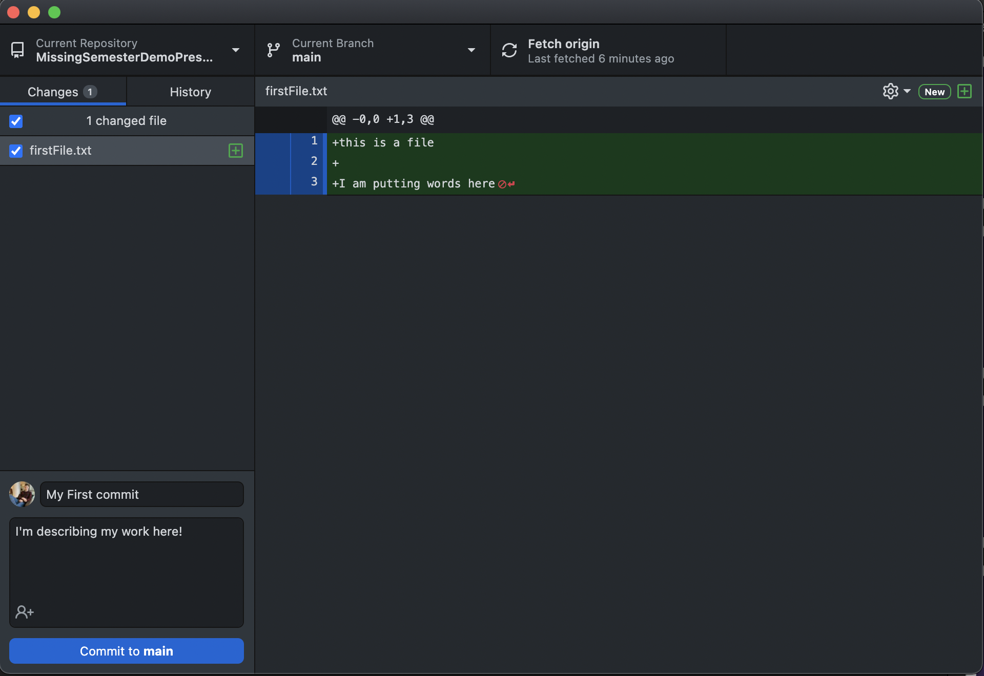
Committing Changes Cont.
Let’s write a commit message and description
Ideally, these should describe the changes you made
Now, create the commit. This saves a version of the file in history, and we can always revert back to it if needed
This will also provide information to other developers about who made these changes and when

Slide 16
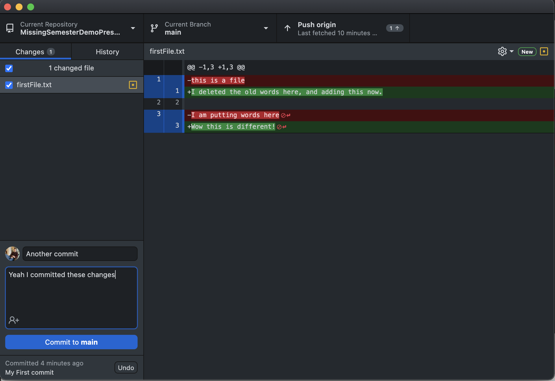
Let’s make some more changes
Make a couple more changes to the file, and go back to Github Desktop
Git highlights what was deleted and what text was edited
Let’s commit these as well

Slide 17
Pushing Your Changes
We’re ready to share out masterpiece with the world
Pushing is the process of taking our commit history from our local machine and putting them in a “remote”.
In our case, the remote is the repository we created and cloned from Github
By pushing our changes, other developers can see them, and edit based off of our changes

Slide 18
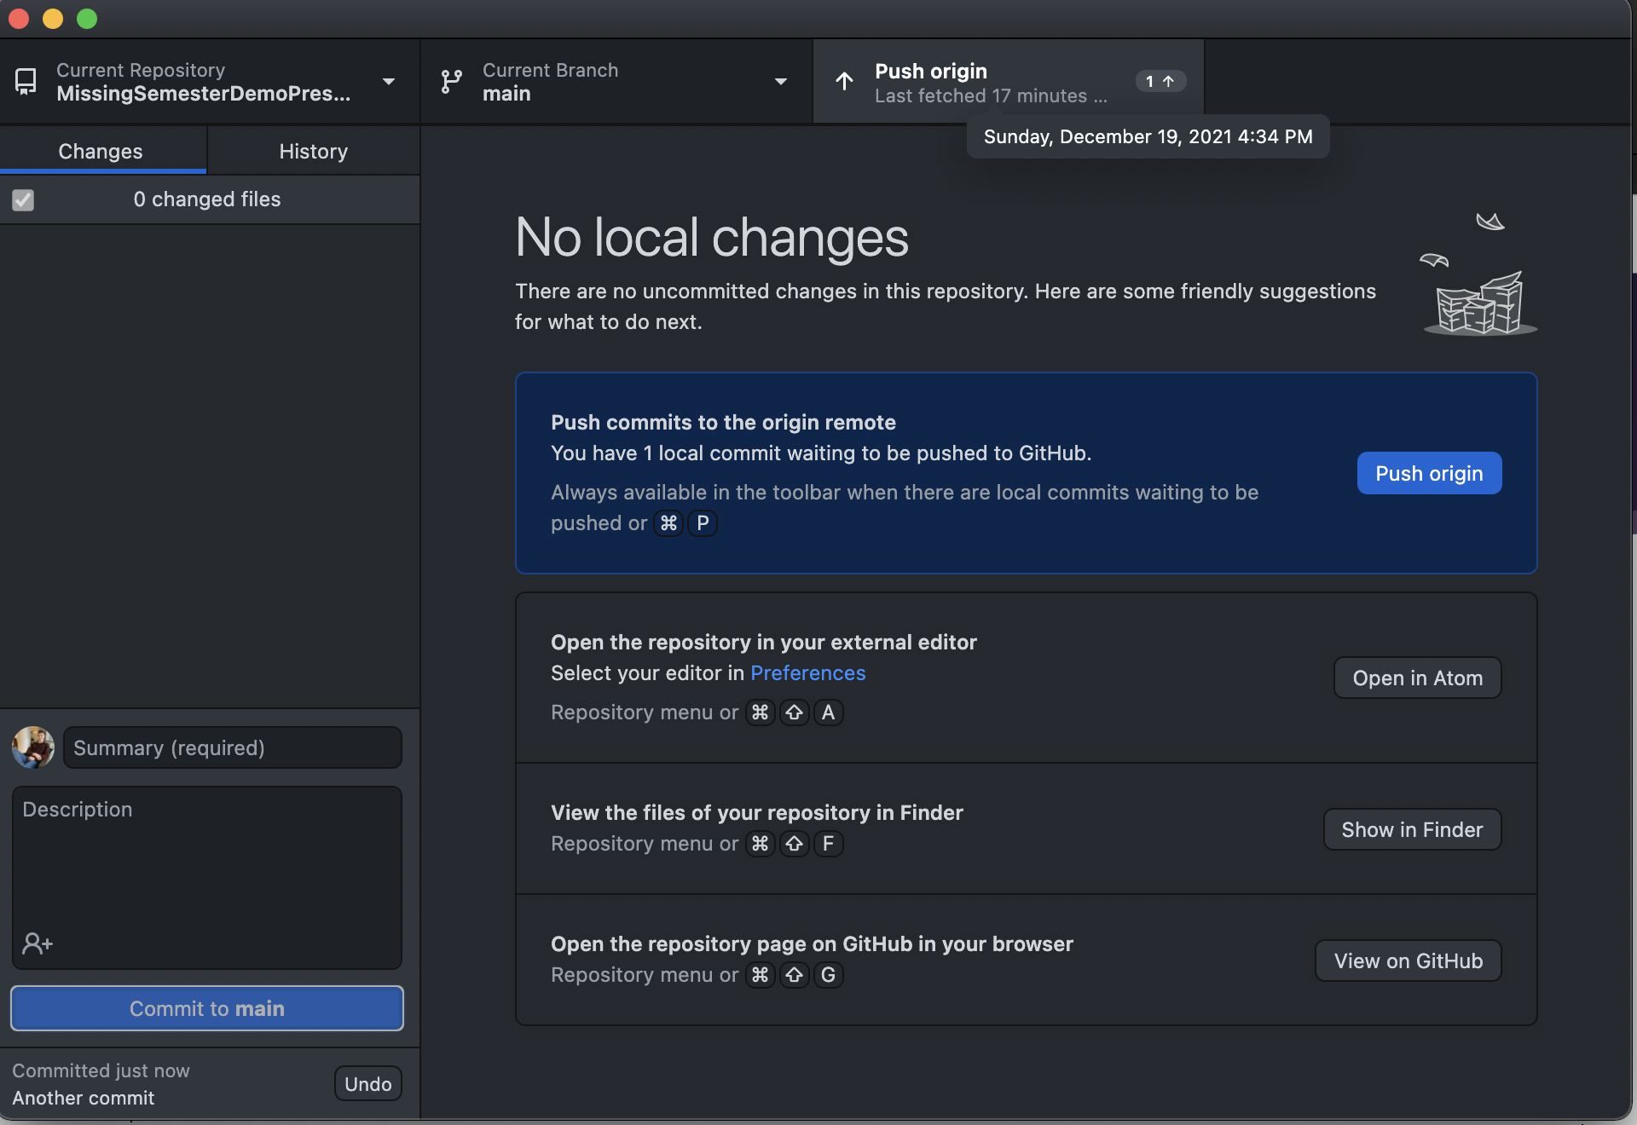
Pushing Your Changes cont.
Simply click “push origin” (the default name for your primary remote), and push our changes to Github.com

Slide 19
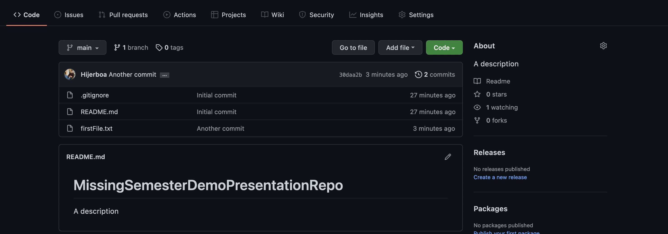
Changes pushed!
We now see our changes in Github.com

Slide 20
What if Others Make Changes?
With Git, we can’t just push our changes we can also add changes made by others to our local copies of the repository
This process is known as “pulling”
With a combination of pushing and pulling, collaboration between developers is incredibly easy, and often seamless

Slide 21
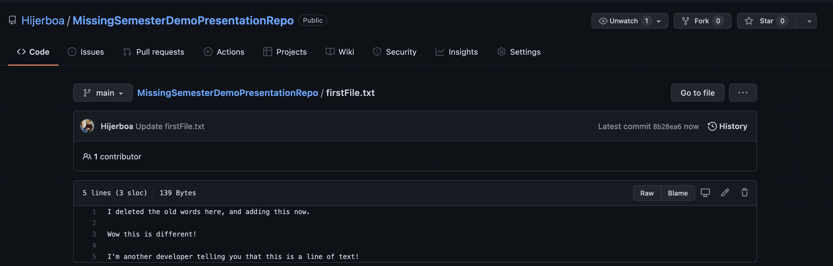
Let’s Simulate Another Developer Making Changes
We’ll use the Github.com web editor to make some changes, then we can pull them our local machine

Slide 22
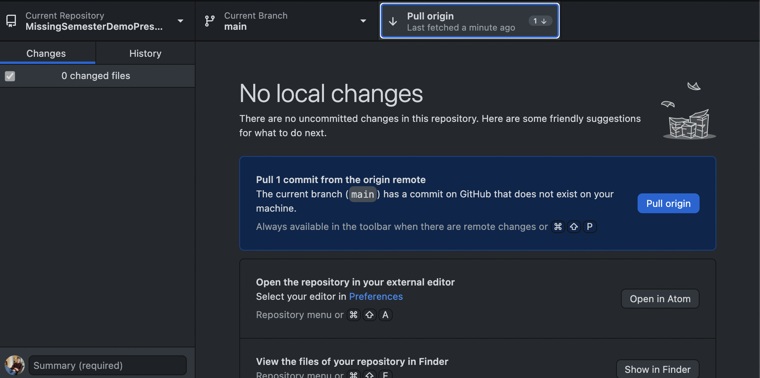
Pull the Changes!
In Github Desktop, click Fetch Origin to see the history from the remote
This is done periodically by Github Desktop in the background
Click Pull Origin to actually make those changes in our local files

Slide 23
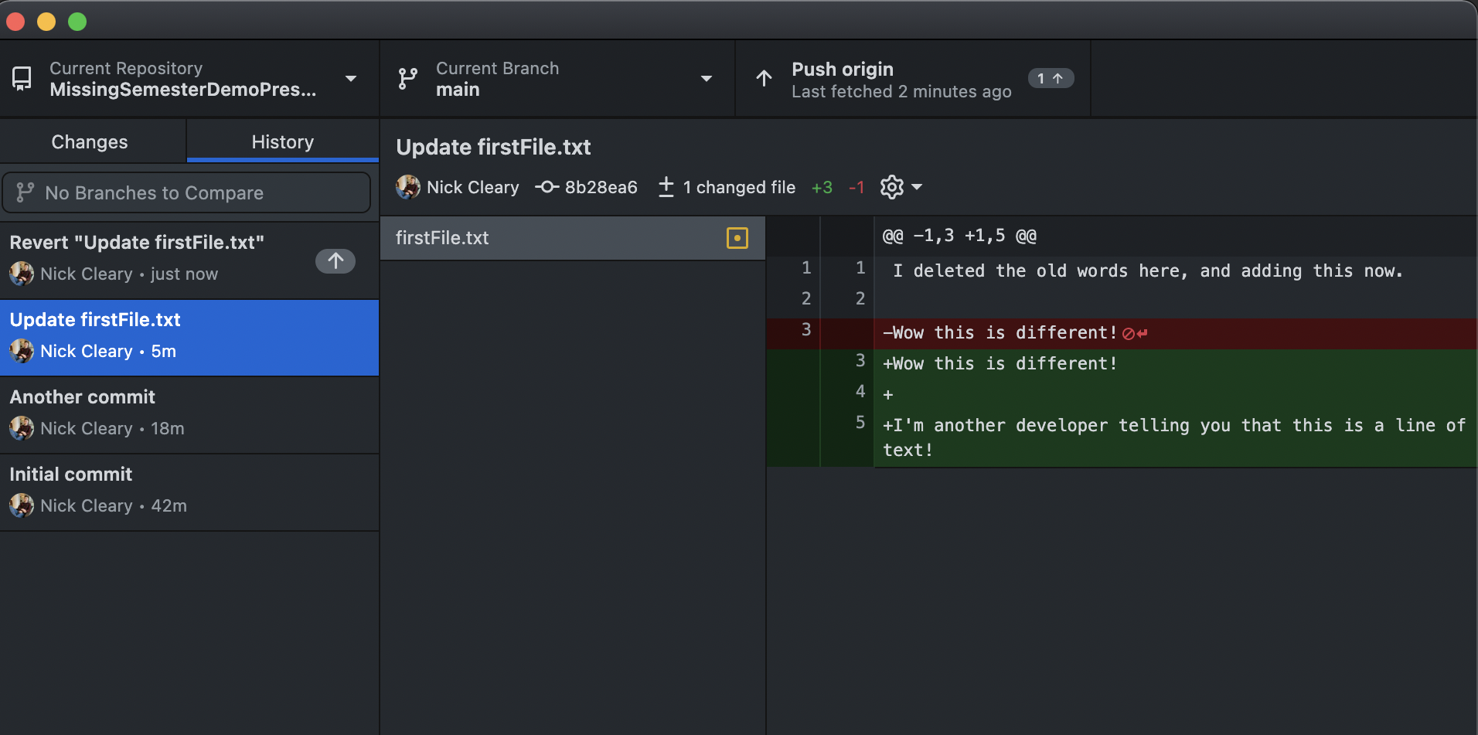
Uh-Oh! You messed up!
What if you want to revert to a pervious version?
Go to the history tab, select a commit, right click, and revert the commit

Slide 24
What’s the ReadMe File Anyway?
A README.md file is typically placed at the root of any project.
Provides documentation and resources to other developers who may use the project
While one is usually present at the root of a project, there’s nothing stopping you from having more Readme’s in other directories
A .md file allows for the usage of MarkDown syntax, which can allow for the addition of tables, code blocks, different headings, and more to the file
Let’s make some changes to the README.md file, and push them to the remote

Slide 25
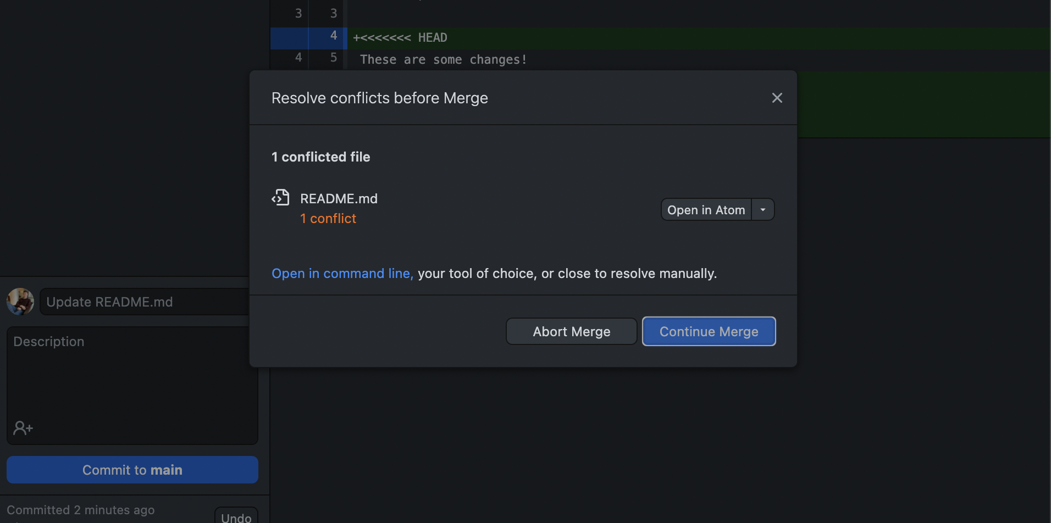
Oh No! Another developer made changes too!
Looks like another developer made changes to the remote and pushed their changes first. VS Code is telling us about a “merge conflict”!

Slide 26
Merge Conflicts
A merge conflict arises when two developer make competing changes to the same file
Usually, Git can resolve changes made by different developers, but when two developers make changes to the same block of code, Git isn’t able to resolve these changes
We are going to have to fix these changes ourself—lets open the file with a merge conflict in VS Code

Slide 27
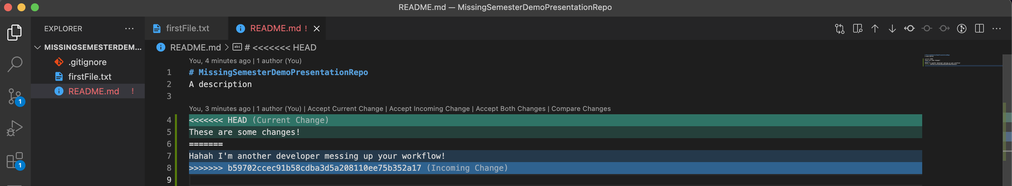
Fixing the Merge Conflict
In VS Code, we can easily select which developer’s version we want to keep
Alternatively, we can manually edit the file and resolve the changes ourselves
Now we can commit the changes and push as normal.

Slide 28
How to Avoid Merge Conflicts
To prevent multiple developers from working on the same code at the same time, and committing competing changes, we use Branches
When a branch is created, it becomes its own copy of the code, and is not affected by changes to other branches
When ready to combine changes back together, developers can create a Pull Request
Pull Requests can be monitored and approved by other developers, and allow for the resolution of merge conflicts all at once, if necessary

Slide 29
Forking
Like making a branch, but copying the entire history of a repo, including all it’s branches, and making it your own
Typically, when working on a large project, one main repository will be created, that all developers create a fork of and work off of on their own
Developers must make sure to keep their private forks in parallel with the main repository

Slide 30
.gitignore
Any file or folder specified in the .gitignore file will not be tracked by Git
Simple regex expressions can be used to specify a large number of files
A rule in the .gitignore written like *.py will ignore all python files
Use this to put files containing secret keys in your local repository, without pushing these changes to the remote

Slide 31
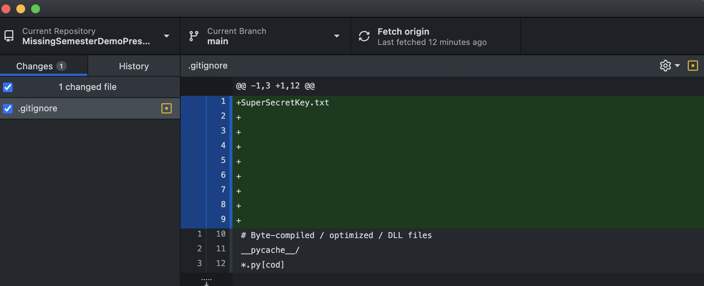
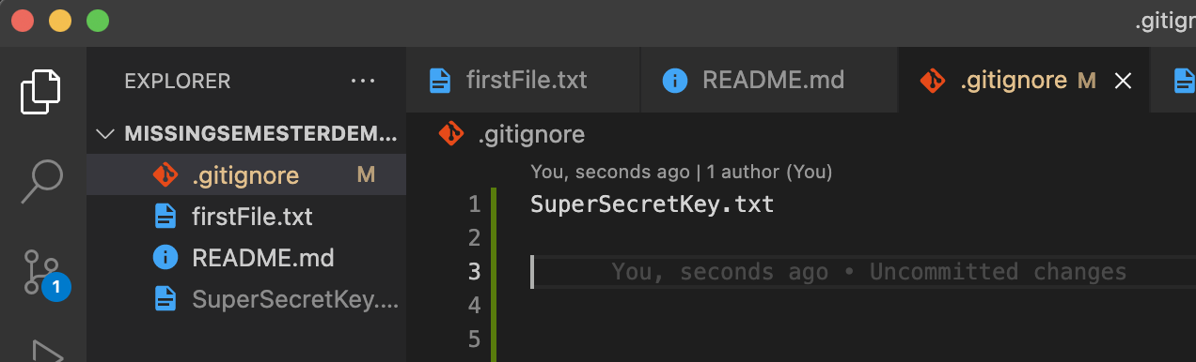
An Example
Git tracked changes to the .gitignore file itself, but not to the file specified to be ignored

